Slide 1
Stretching Moore’s law: quantum design of materials and devices for classical computation
Nima Leclerc
Griffin Group, LBNL
January 6 , 2020

Slide 2
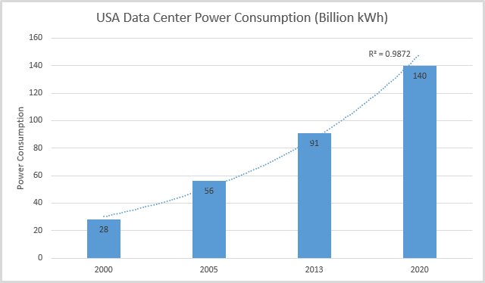
Computing contributes a considerable amount to energy grid

Slide 3
Microelectronics are growing in demand
IOT
Machine Learning
Cloud storage

Slide 4
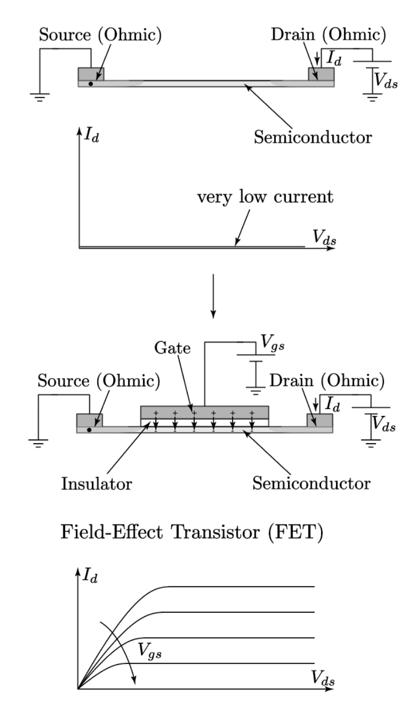
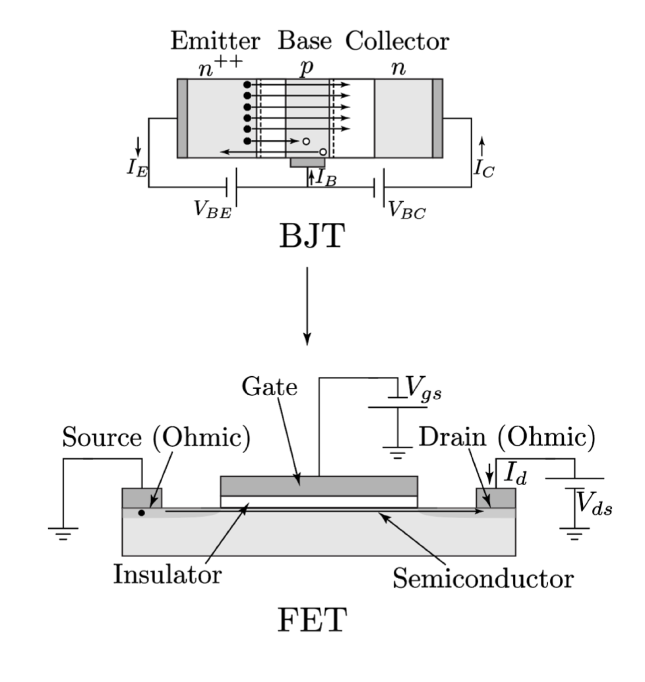
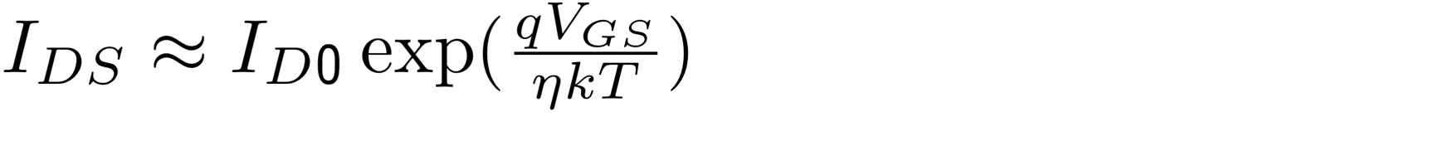
The current paradigm of microelectronics

Slide 5
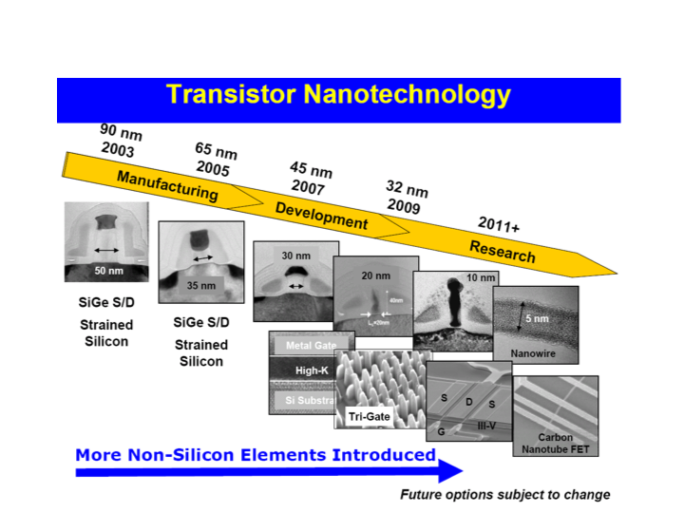
Moore’s law is dying
Gordon Moore

Slide 6
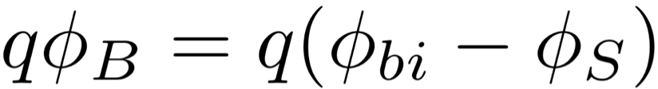
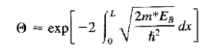
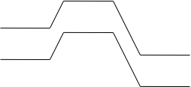
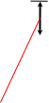
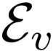
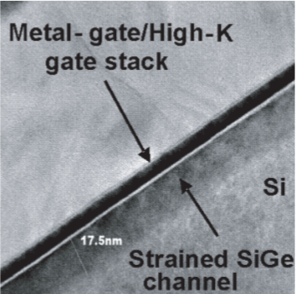
Today’s microelectronics not sufficient to sustain Moore’s law

Slide 7
QM to engineer next-generation microelectronics

Slide 8
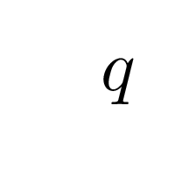
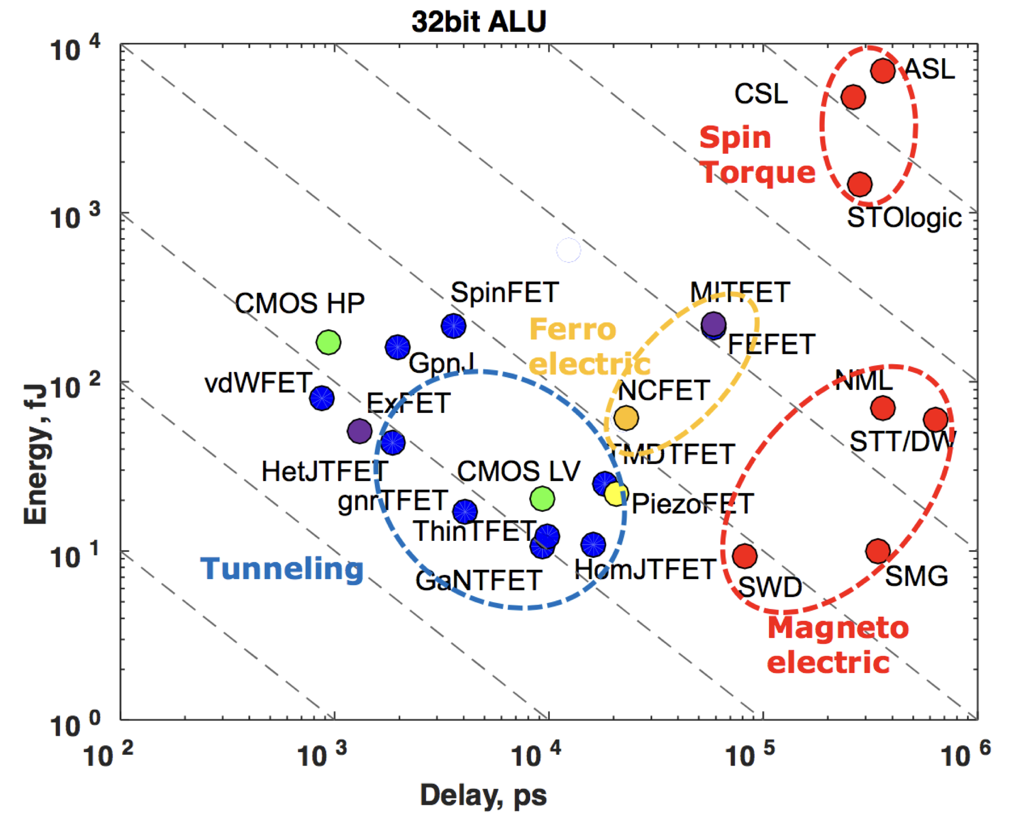
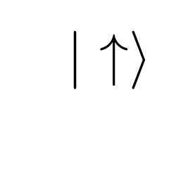
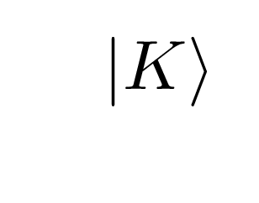
Smaller and lower energy needs to go beyond charge
Photonics, superconductors,
new semiconductors?

Slide 9
First principles techniques to guide materials design
Define engineering figure of merit (i.e. coherence time)
Identify material properties most responsible for FOM
Obtain mapping from wavefunction/energy to property
Compute wavefunctions/energy and properties for max FOM
Vary experimental parameters predicted from theory

Slide 10
Quantum approach to device/material design
Material design in conjunction for better information storage/processing [materials for RSFQ devices]
Material design for reliable communication [suppression of low-frequency noise mechanisms]

Slide 11
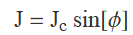
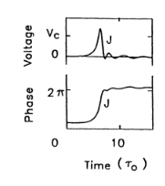
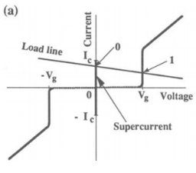
Rapid single flux quantum logic (RSFQ)
NbN
Tunnel barrier
NbN
Josephson Junction
“the simplest basic components of the RSFQ family … were demonstrated to work at clock frequencies in excess of 100 GHz”^{[Weinstock]}
Objective: explore new materials demonstrating high clock speeds, high critical current, and long coherence times

Slide 12
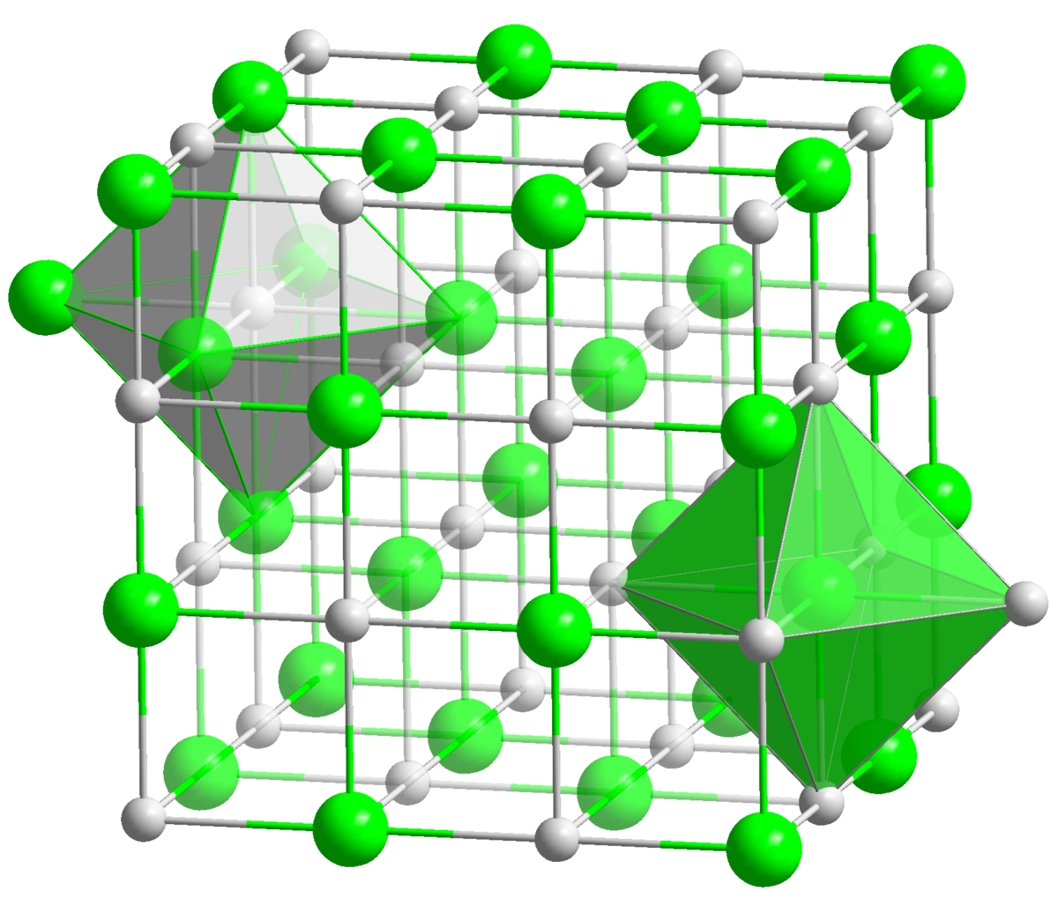
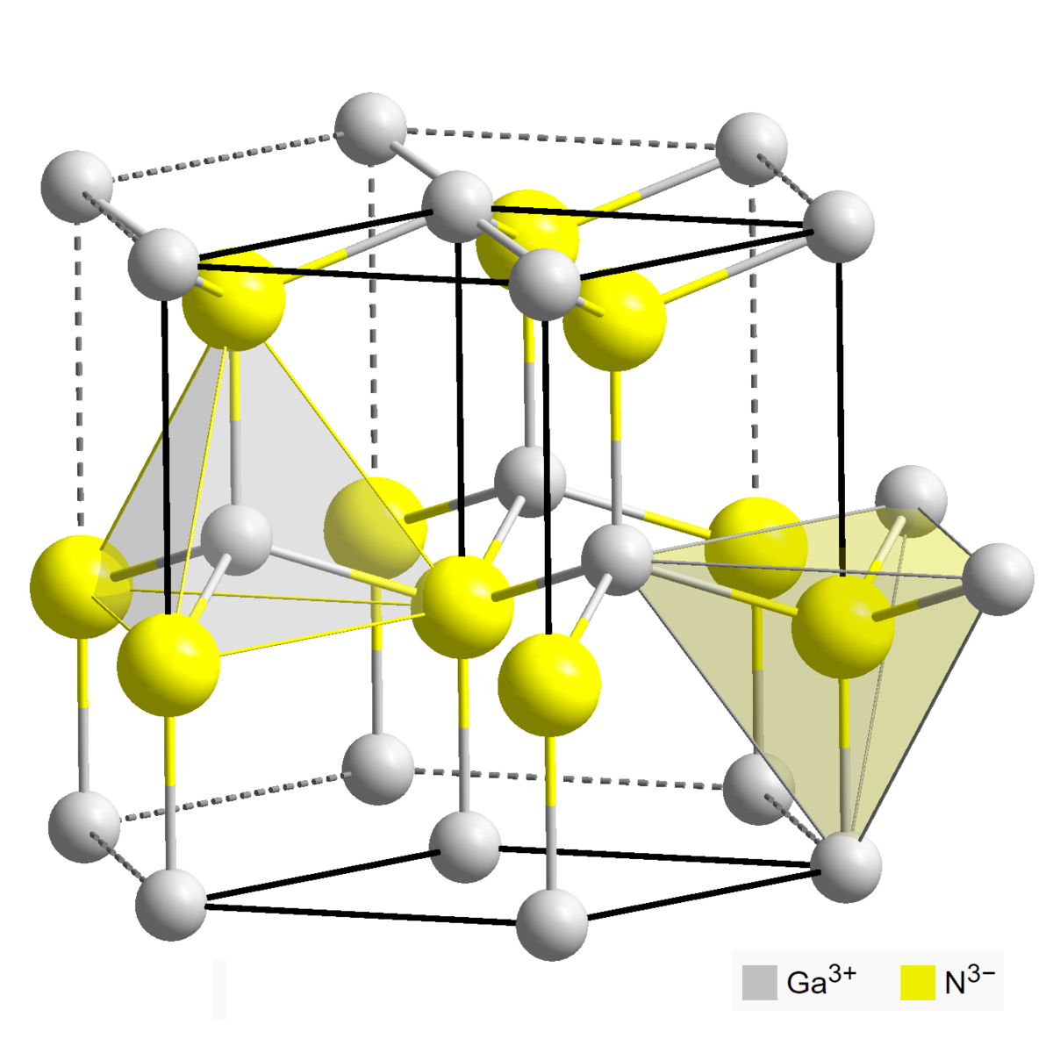
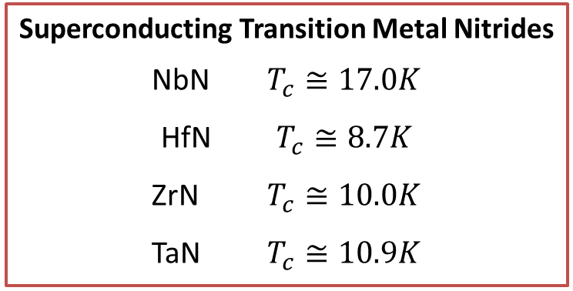
Material platforms for III-V based JJs
GaN, AlN
NbN
Superconducting Transition Metal Nitrides
NbN $T_{c}≅17.0K$
HfN $T_{c}≅8.7K$
ZrN $T_{c}≅10.0K$
TaN $T_{c}≅10.9K$
Lengauer, W., Surf. and Int. An 15 (6), 1990
commons.wikimedia.org/wiki/File:NaCl_polyhedra.png
en.wikipedia.org/wiki/File:Wurtzite_polyhedra.png

Slide 13
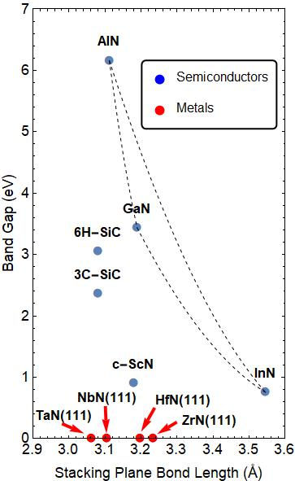
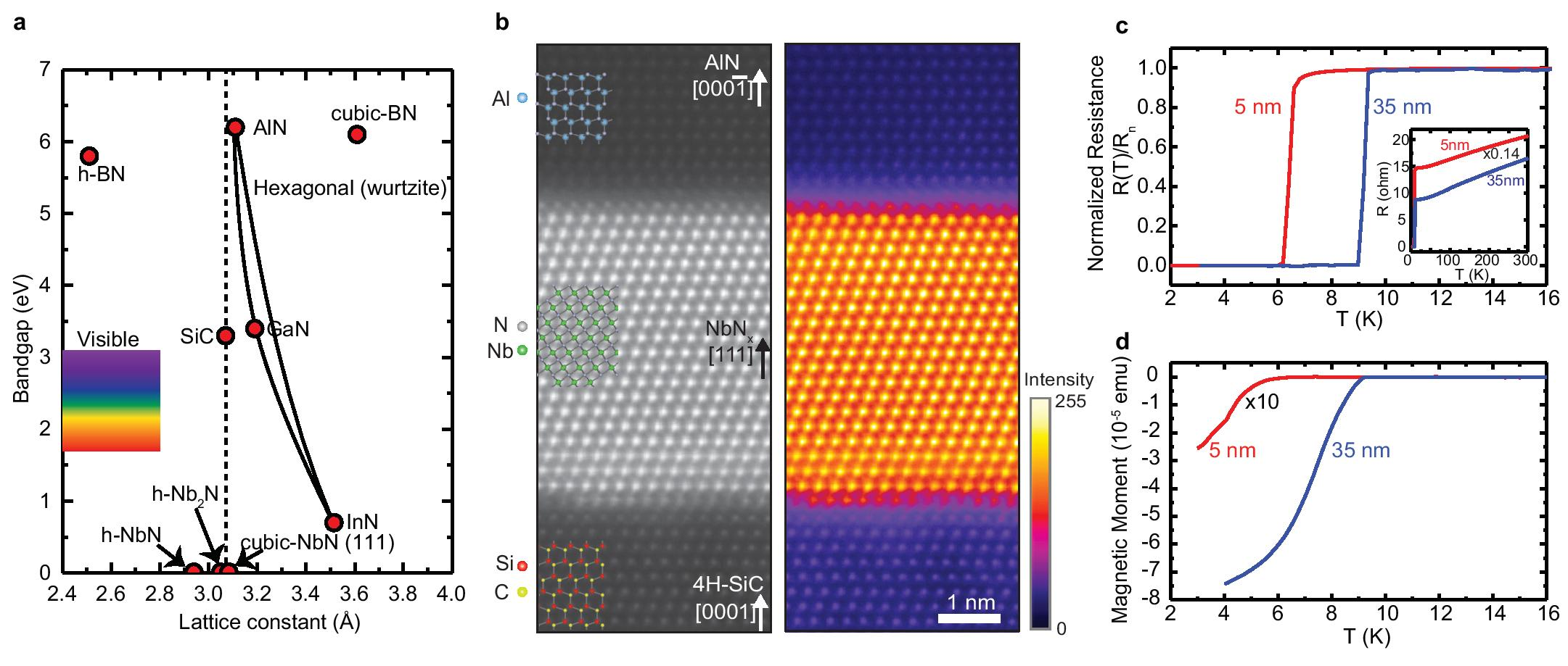
Compatibility of NbN superconductor with GaN (and AlN)

Slide 14
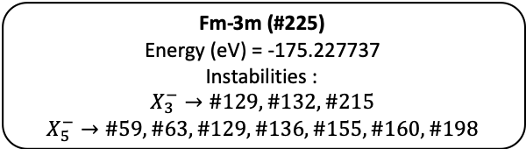
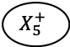
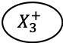
Exploring phase space for epitaxial growth
Fm-3m (#225)
Energy (eV) = -175.227737
Instabilities :
$$X_{3}^{−}→\#129, \#132, \#215$$
$$X_{5}^{−}→\#59,\#63,\#129,\#136,\#155,\#160,\#198$$
$$X_{3}^{+}$$
$$X_{5}^{+}$$
P4/nmm (#129)
Energy (eV) = -175.766499
Instabilities : None
P2_13 (#198)
Energy (eV) = -175.298138
Instabilities :
$$X_{3}^{−}:\#1→\#215, \#4→\#129, \#146→\#215$$
$$X_{5}^{−}:\#19→\#62$$
R3m (#160)
Energy (eV) = - 175.814854
Instabilities : $None→\#215$
P4_2/mcm (#132)
Energy (eV) = -175.792342
Instabilities : None
P4_2/mnm (#136)
Energy (eV) = - 175.407275
Instabilities :
$$X_{3}^{−}:\#65→\#132, \#84→\#132,\#113→\#129$$
R32 (#155)
Energy (eV) = - 175.313464
Instabilities :
$$X_{3}^{−}:\#5→\#132 \#146→\#215$$
P-43m (#215)
Energy (eV) = -175.814899
Instabilities : None
P4/nmm (#129)
Energy (eV) = - 175.470703
Instabilities :
$$X_{3}^{−}:\#11→\#129, \#12→\#132$$
Cmcm (#63)
Energy (eV) = -175.415410
Instabilities :
$$X_{3}^{−}: \#12 →\#129, \#51→\#129, \#57→\#129$$
$$X_{5}^{−}:\#59→\#129$$
Pmmn (#59)
Energy (eV) = -175.430787
Instabilities :
$$X_{3}^{−}:\#11→\#129$$

Slide 15
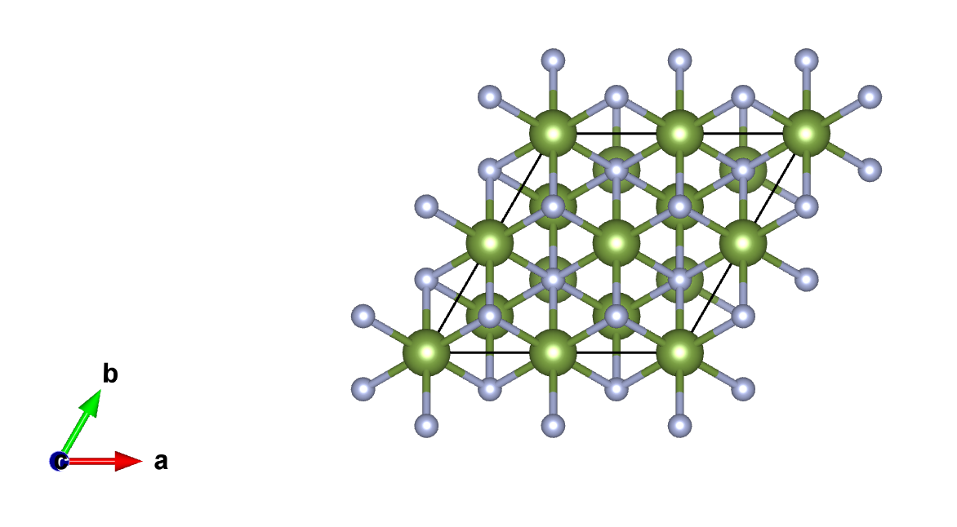
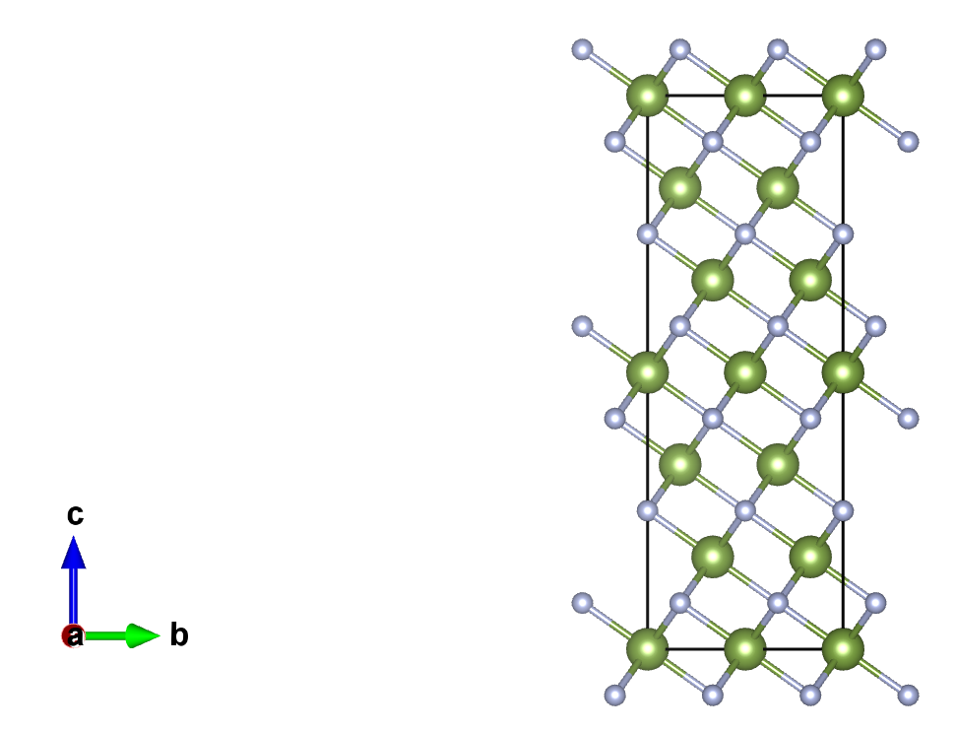
Exploring phase space for epitaxial growth cont’d
In-plane lattice constants forced to be the same. Increases the energy of $\#129$ and $\#136$

Slide 16
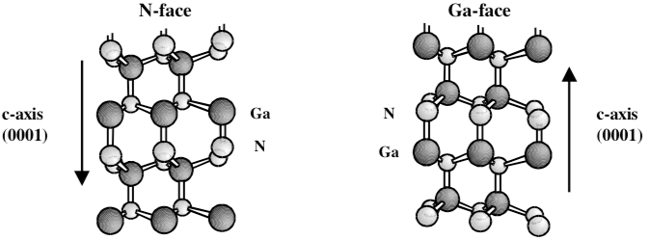
Polarity engineering for better transport
GaN [000 -1]
NbN [111]
GaN [0001]

Slide 17
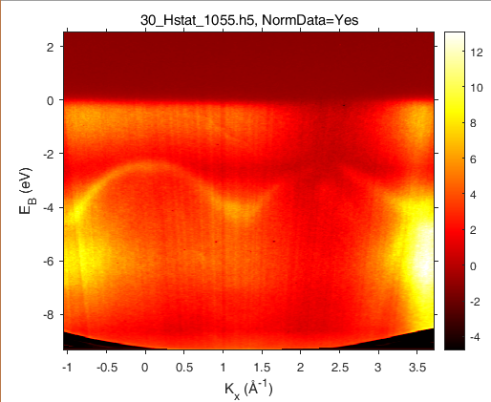
Improving transport (maximize tunneling probability)
NbN
n-GaN
~2.3 eV
4.1eV
4.95eV
~2 eV
3.4eV

Slide 18
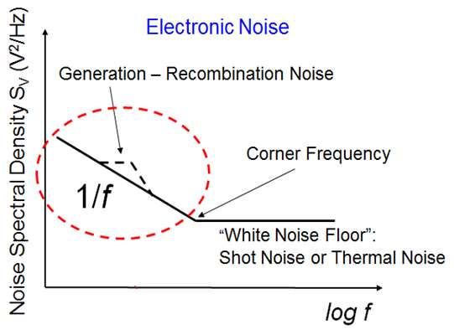
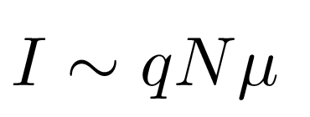
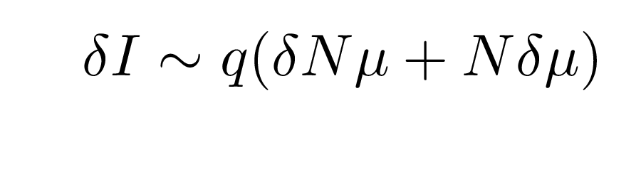
Noise is frequency dependent: draw focus to 1/f noise
1/f noise due to generation-recombination effects, acoustic phonon scattering, impurity scattering, etc.
Observed in frequency range of 0 – 1 MHz
Large device-to-device variation in noise spectrum

Slide 19
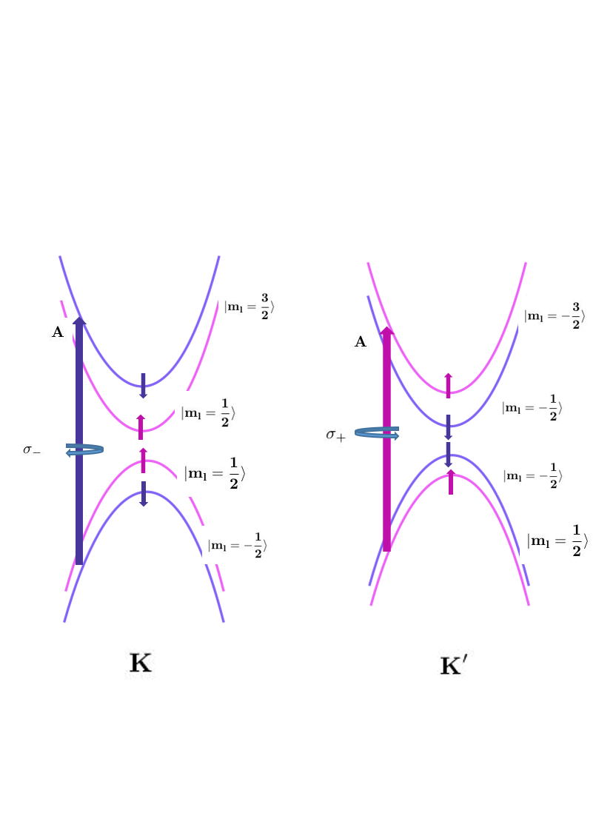
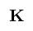
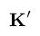
Valleytronics: an overview
Energy
Crystal Momentum

Slide 20
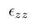
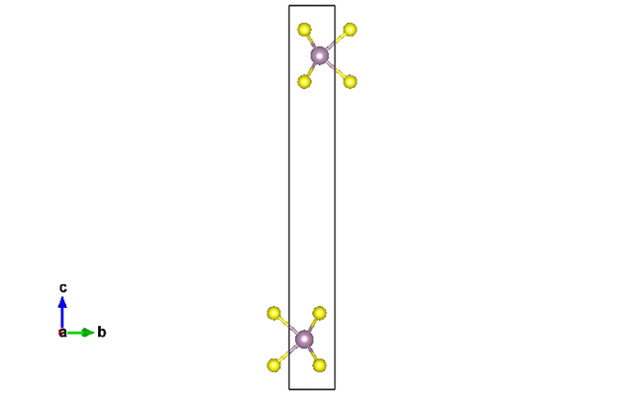
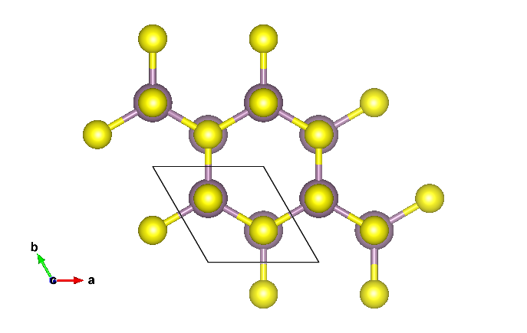
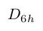
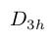
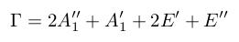
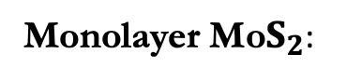

Material platform for valleytronics: 2D TMDs
Bulk Mo$S_{2}:$
Monolayer Mo$S_{2}$:
2D Confinement
Indirect gap, possesses 18 phonon modes, inversion symmetry present.
Emergence of direct gap, degeneracies at K/K’ points, piezoelectricity, possesses 3 etc.

Slide 21
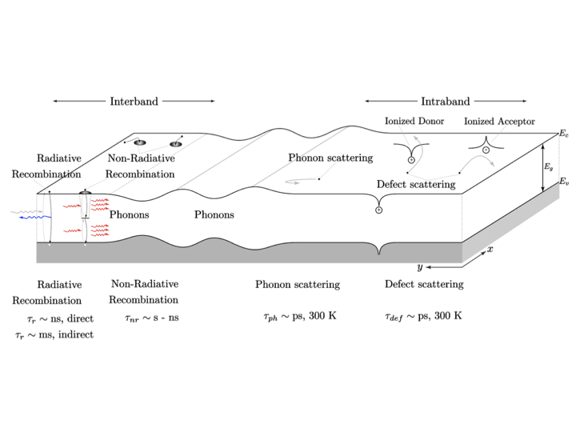
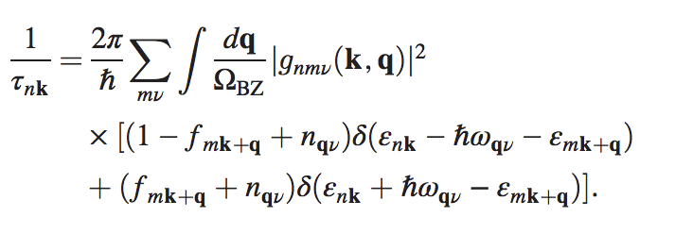
Scattering is a problem

Slide 22
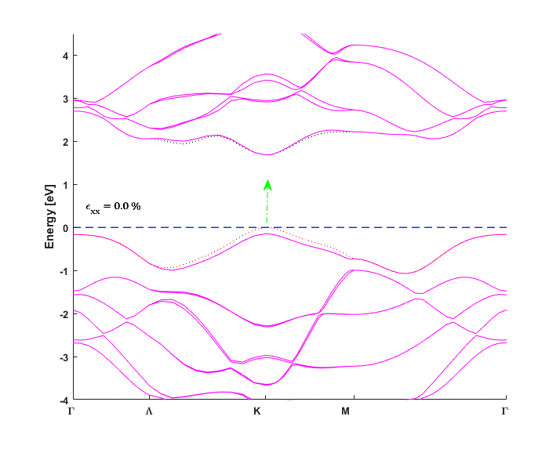
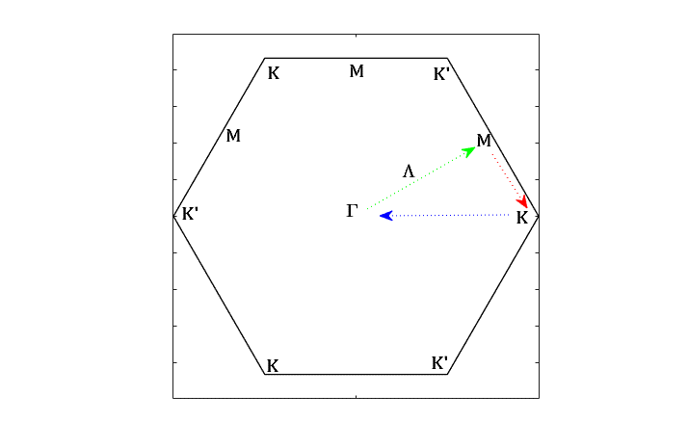
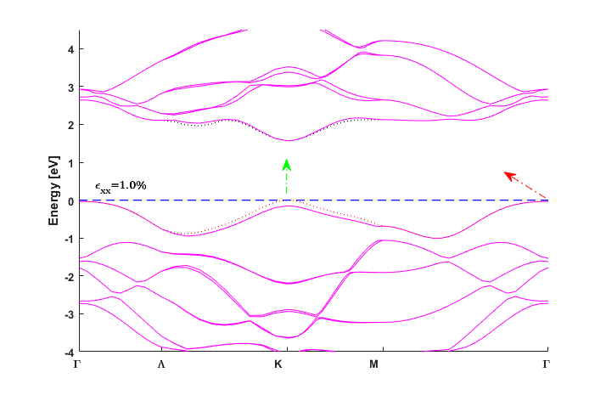
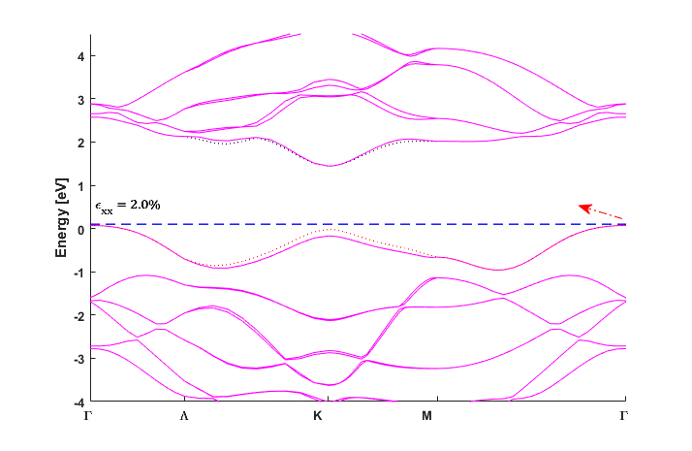
Using strain engineering to increase valley lifetime

Slide 23
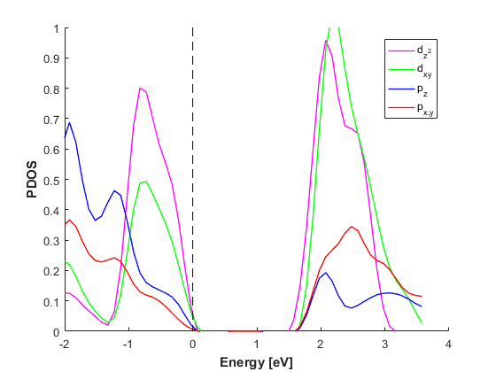



Using strain engineering to increase valley lifetime (cont’d)

Slide 24





















Using strain engineering to increase valley lifetime (cont’d)
Energy increase
Fermi level increase

Slide 25
Next steps with this…
Look at entire valley lifetime predictions with applied strain
Experimental realization of strained TMDs ➔ exciton lifetimes with strain

Slide 26

Going smaller and more energy efficient will require quantum
Name: Nima Leclerc
Email: nl475@cornell.edu or nleclerc@lbl.gov
LinkedIn: linkedin.com/in.nimaleclerc
Git User: nimalec

